Slide 1
Course
AWS Cloud Practitioner
MaxCloud

Slide 2
03
Class
Amazon ECR
Amazon ECS
Amazon EKS

Slide 3
Amazon Elastic Kubernetes Service
Amazon Elastic Kubernetes Service (Amazon EKS) is a managed service that eliminates the need to install, operate, and maintain your own Kubernetes control plane on Amazon Web Services (AWS).
Kubernetes is an open-source system that automates the management, scaling, and deployment of containerized applications.

Slide 4
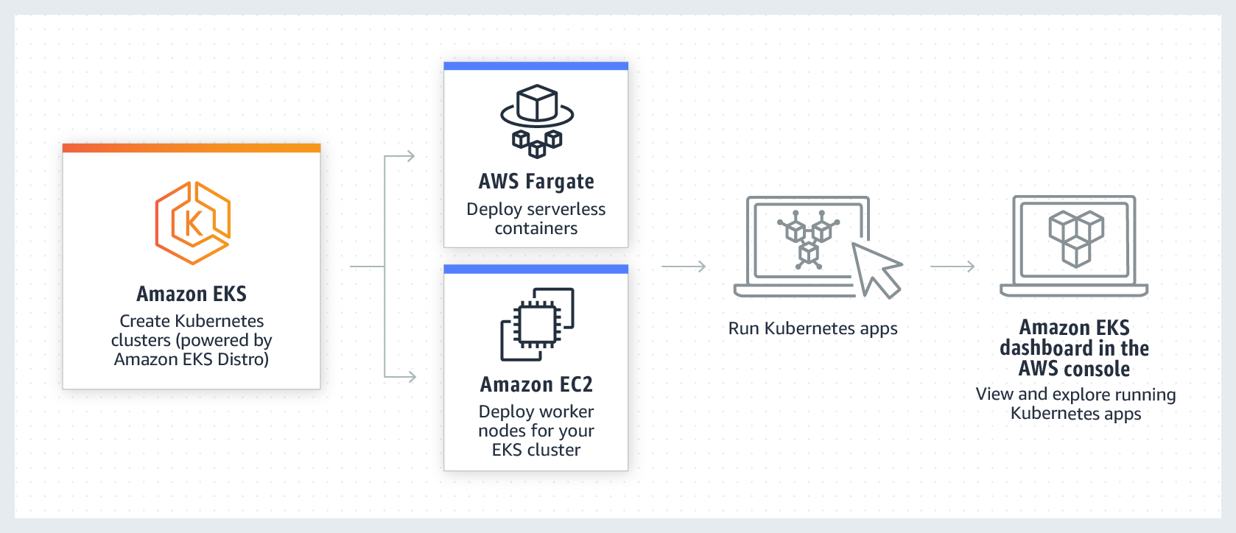
Amazon EKS

Slide 5
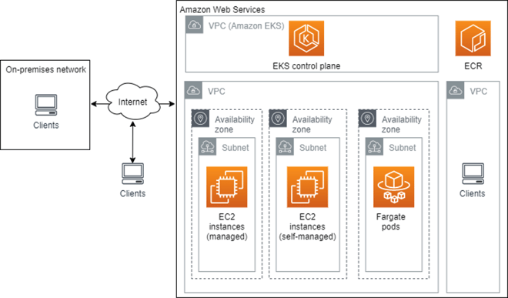
Amazon EKS control plane

Slide 6
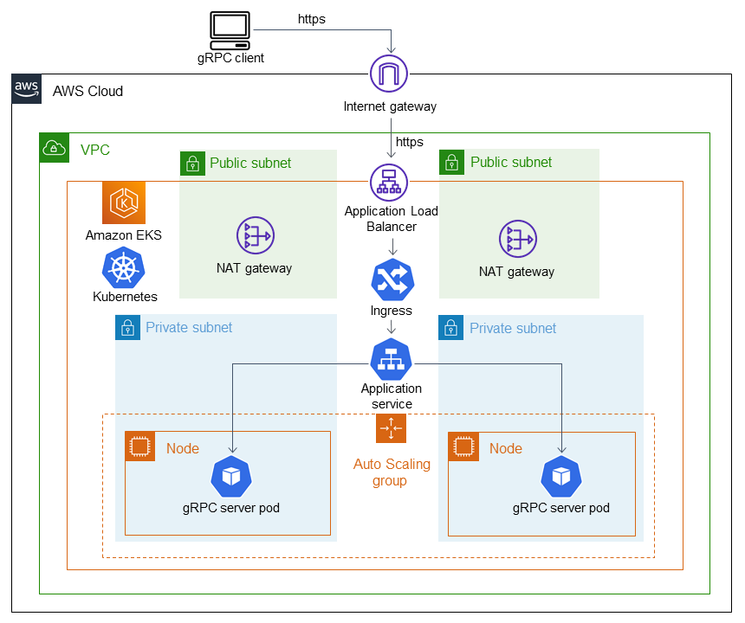
Amazon EKS deployment

Slide 7
Muchas Gracias

